Slide 1
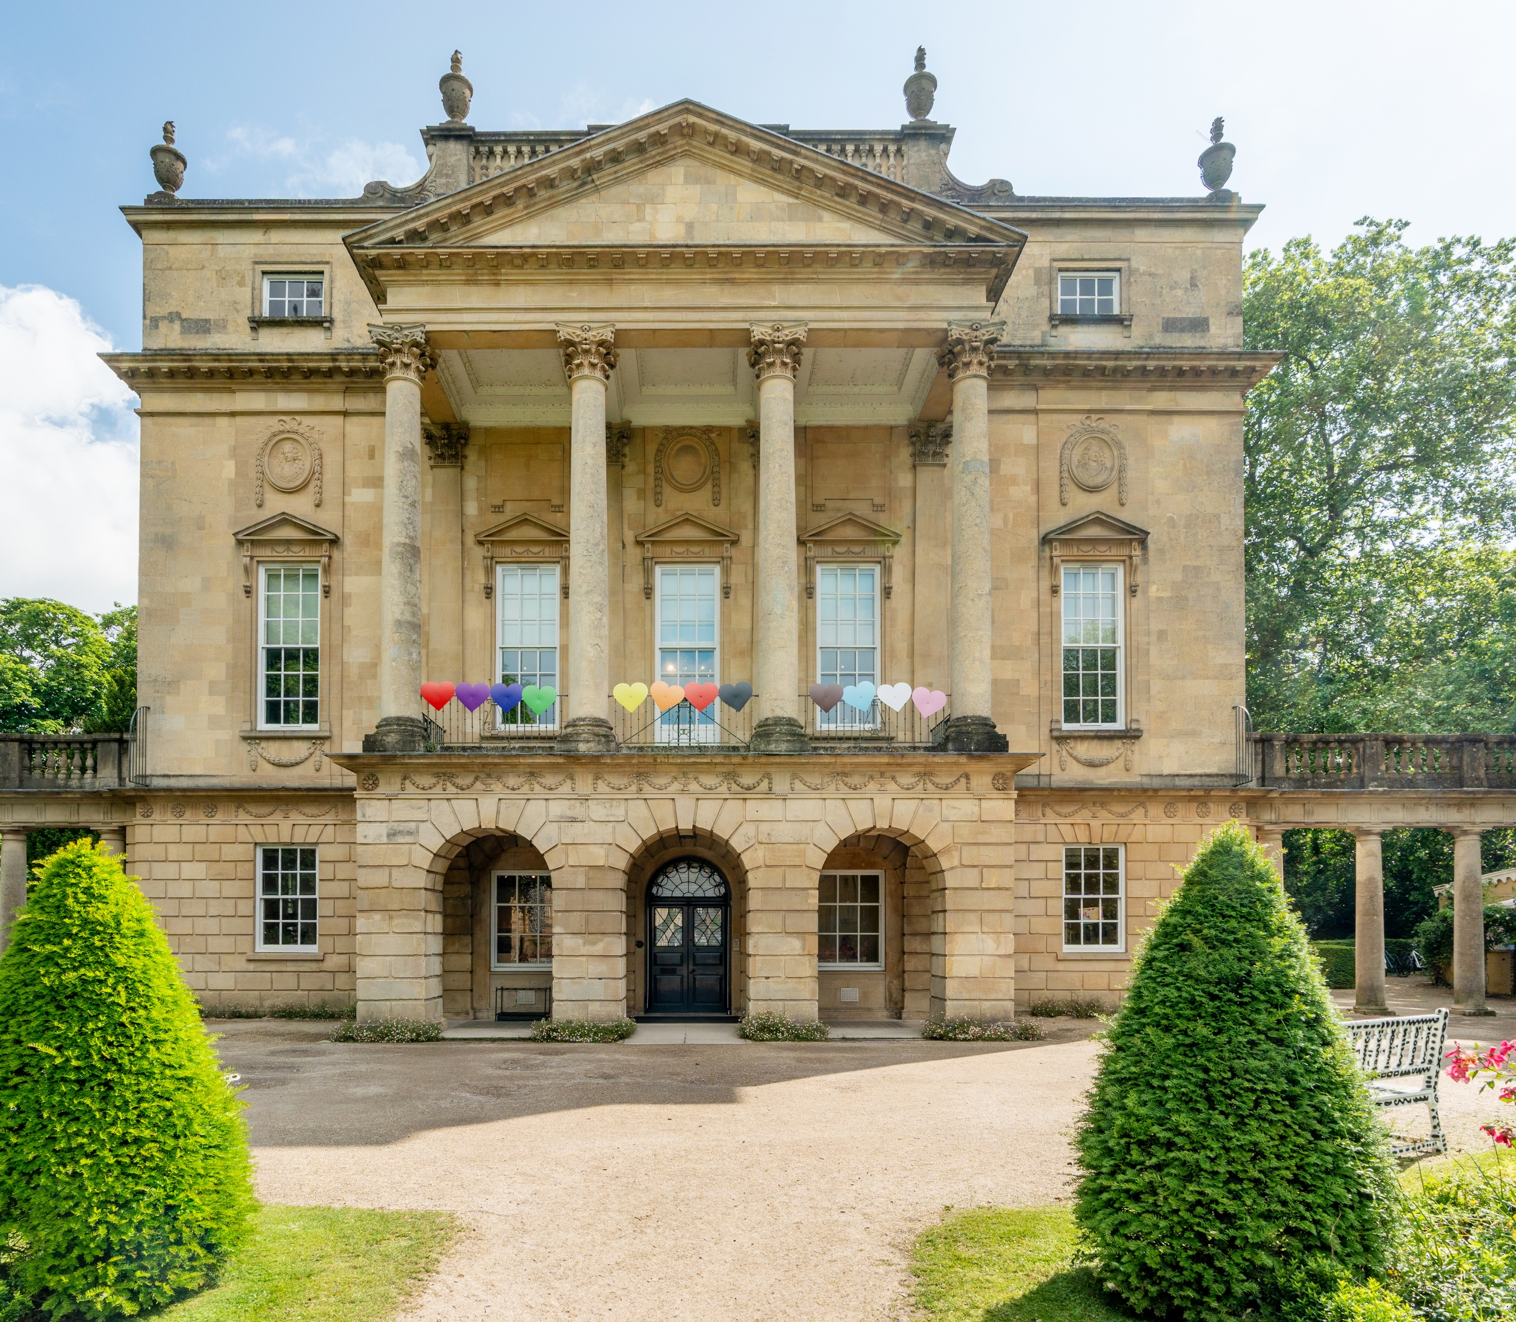
Discover the Holburne Museum
Explore the Holburne Museum collection – home to thousands of objects!
The images on these slides show real objects from the museum, linking to the different locations and themes explored in the loans box.

Slide 2
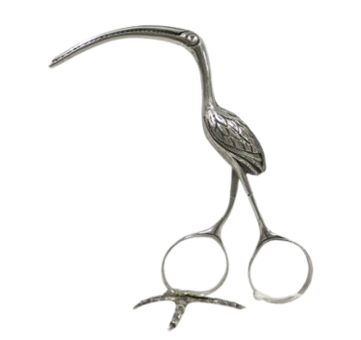
What was this object used for ?
1
Get ready with William Holburne
This object is a ribbon puller, from the late 1700’s. It looks like a bird called a stork. You would have used this object to help your thread ribbons into clothing by threading them through the bird’s beak.

Slide 3
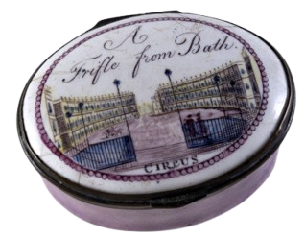
What was kept in this box?
1
Get ready with William Holburne
This is a patch box. Georgian’s would have used it to store their face patches. Patches were small bits of black leather or material, they were stuck to the face to look fashionable and also to cover scars.

Slide 4
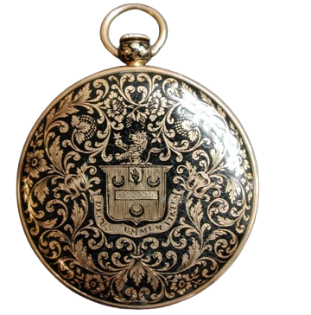
Who owned this?
1
Get ready with William Holburne
This object is a special pocket watch, owned by William Holburne. He would have carried this pocket watch in his pocket for easy time keeping! If you look closely you can see the Holburne family crest (with a lion on top) in the middle.

Slide 5
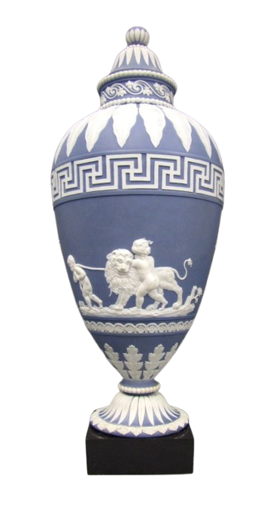
A
Investigate a Roman Discovery Site
What are these type of patterns called?
This is a ceramic made by Josiah Wedgwood, in his popular blue jasperware (a type of coloured clay). He was very inspired by ancient Greek and Roman designs and often added repeating key patterns (like these ones) to his pieces.

Slide 6
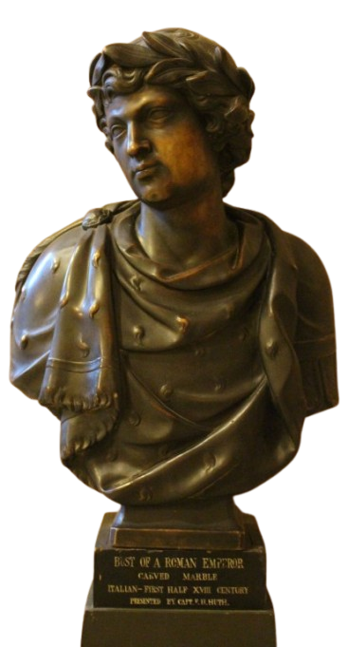
Who do you think this sculpture is of?
A
Investigate a Roman Discovery Site
On the base of this sculpture it says ‘Bust of a Roman Emperor’ – we don’t know if it is of a real Emperor, or the artist made them up!
The sculpture is made out of marble, but painted to look like a bronze statue.

Slide 7
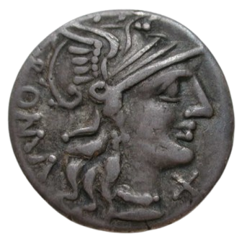
How old is this?
Investigate a Roman Discovery Site
A
There are lots of coins in the Holburne collection, including some dating from the Roman Empire. We think this coin was made after 439 BC, which (if real!) would make it over 2400 years old!

Slide 8
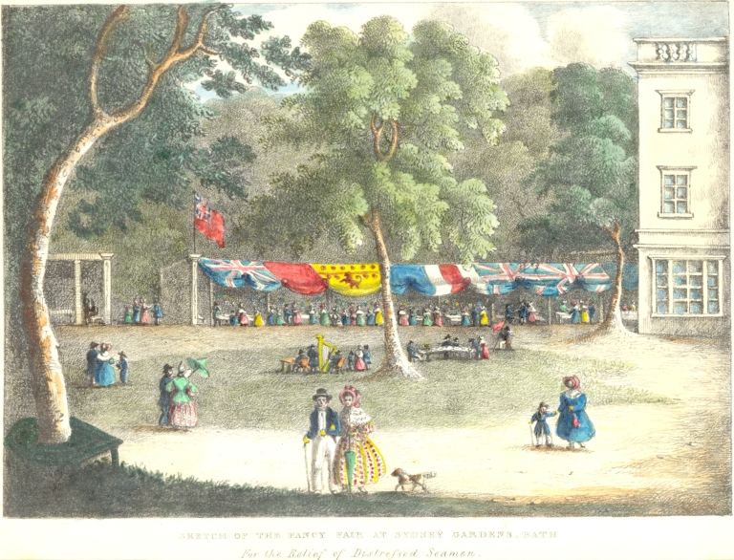
What’s happening here?
Explore the Pleasure Gardens
D
In this print from 1836 you can see visitors to the Pleasure Gardens enjoying meals in supper boxes (look at the coloured flags). These were boxes that you could reserve to eat a meal with others.

Slide 9
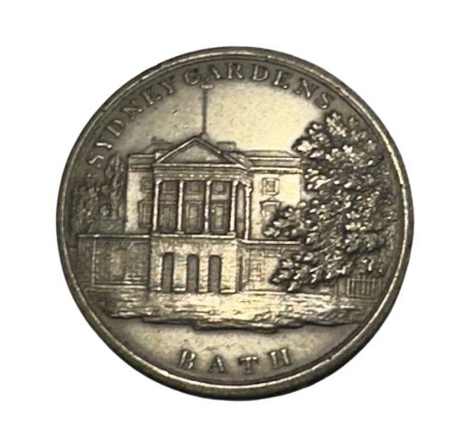
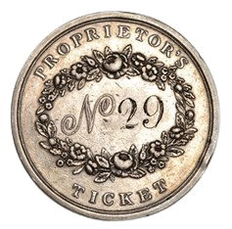
Real or Fake?
Explore the Pleasure Gardens
D
These are called spring tokens, they would be given to visitors to prove they had paid entry to the gardens. You can see the museum on the front of the token (at that time it was The Sydney Hotel). We have some of these tokens in museum the collection, including fake ones!

Slide 10
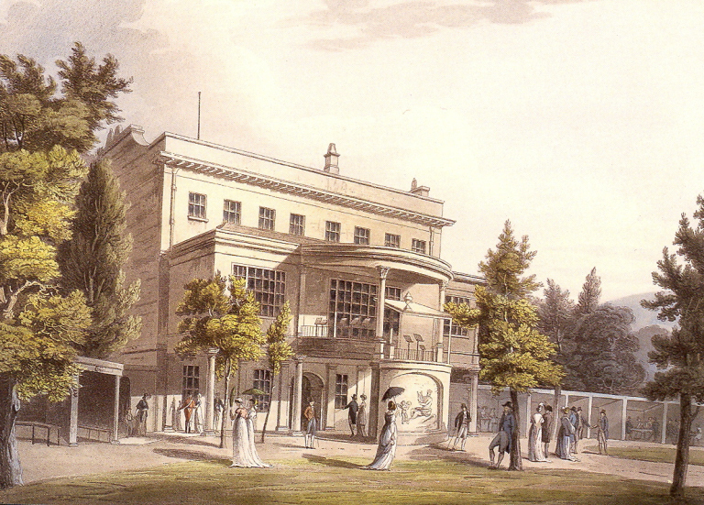
Where is this?
Explore the Pleasure Gardens
D
In this print you can see what the back of the museum (then a hotel) looked like. It had a bandstand on the middle floor where musicians would play to visitors as they walked around the gardens below.

Slide 11
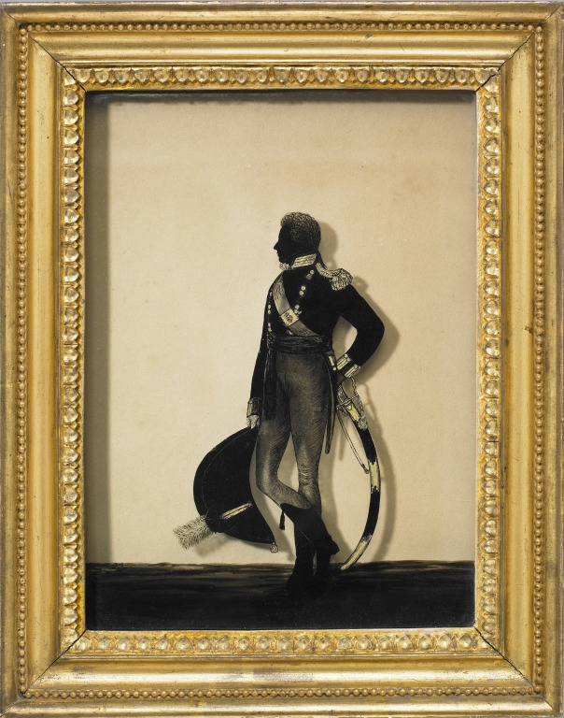
Who is this?
Have your silhouette made by
William Hamlet
E
This portrait is of Captain Francis Holburne, brother of the museum’s founder William Holburne. Francis was a soldier in the army, he sadly died as young man from battle wounds. Artist William Hamlet made this portrait of him by painting onto glass.

Slide 12
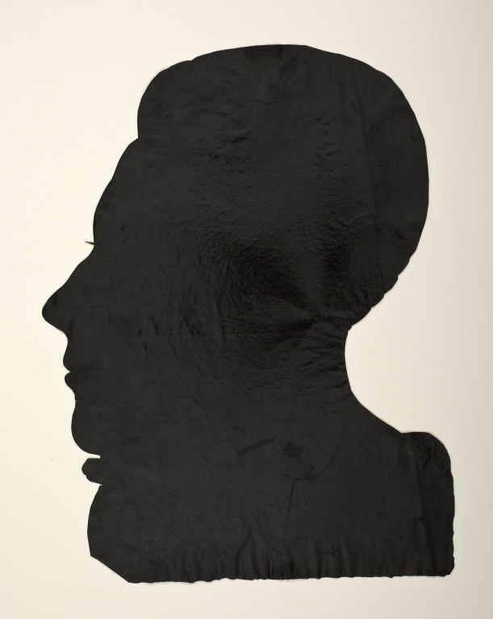
Why make this?
Have your silhouette made by
William Hamlet
E
Here is another portrait of Captain Francis Holburne made by William Hamlet, but this time made from cut out paper. This is the traditional way of making a silhouette portrait that Hamlet was most known for. Having a silhouette portrait made was a quicker and cheaper way for someone to have their likeness captured.

Slide 13
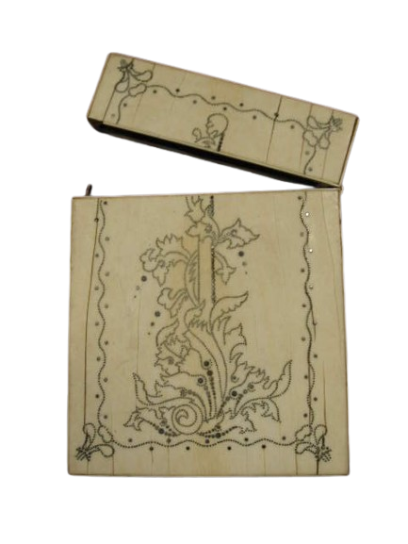
What was kept in here?
Dance at a Georgian Ball
B
Not just a pretty object, but a practical one too. This case is made from ivory (animal tusk or teeth) and would have contained a set of playing cards. Card games would have often been played at Georgian Balls in card rooms, that joined onto main Ballrooms.

Slide 14
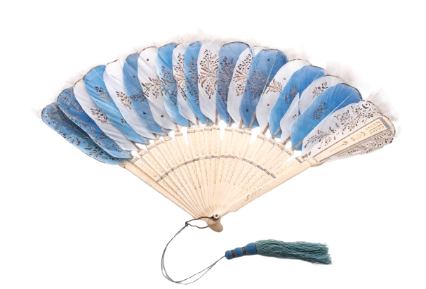
What is this made from?
Dance at a Georgian Ball
B
Another beautiful but useful object. This fan has been made from single feathers, that have been hand painted with floral patterns. You would need a fan to help you stay cool in a hot and busy ballroom.

Slide 15
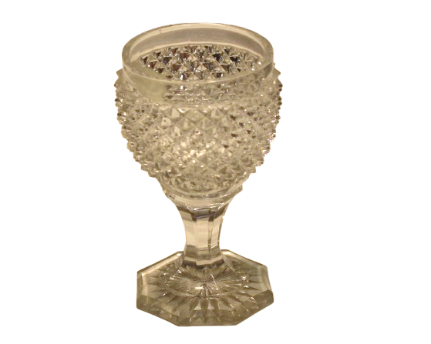
What was this used for?
Dance at a Georgian Ball
B
A busy evening of dancing and talking would make a person thirsty! Light refreshments would be served including cakes and jellies, with drinks like punch, lemonade, tea and coffee.

Slide 16
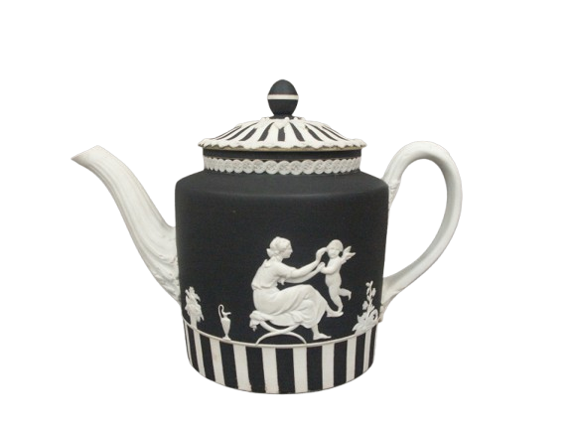
Would you buy this?
Go shopping at Wedgwood
C
Not quite like the kettle you might have at home. This Wedgwood teapot has been made inspired by classical Roman and Greek designs, something that you see on lots of Wedgwood ceramics.
Spot the cherub flying next to the female figure.

Slide 17
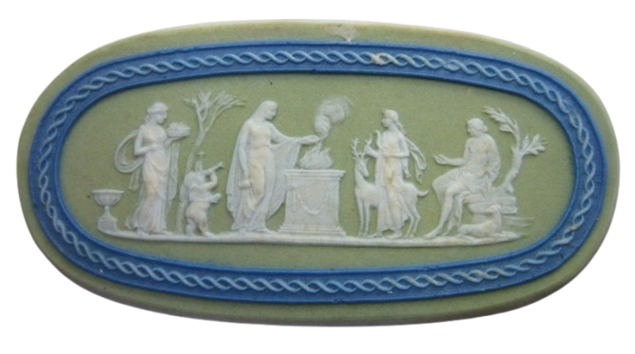
What was this used for?
Go shopping at Wedgwood
C
Small plaques like this one were an affordable way of a piece of Wedgwood. Small pieces like this were produced and added as decoration to portraits, furniture and fireplaces.

Slide 18
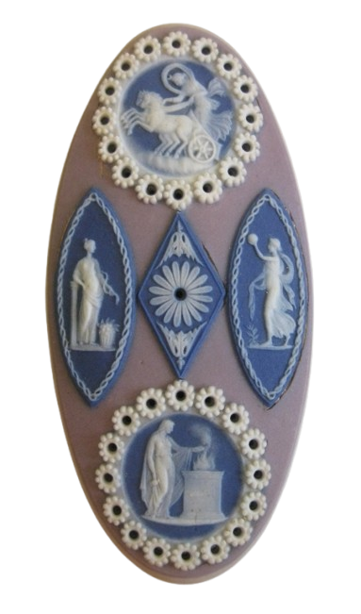
What can you see?
Go shopping at Wedgwood
C
Even smaller Wedgwood! These even smaller plaques were made to be attached to shoe buckles. Can you spot the goddess Diana riding on her chariot? In the 18th century men would often wear matching shoe and knee buckles to complete their outfit.

